Slide 1
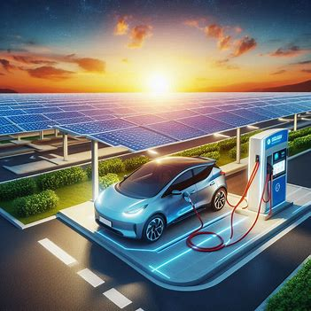
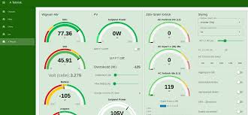
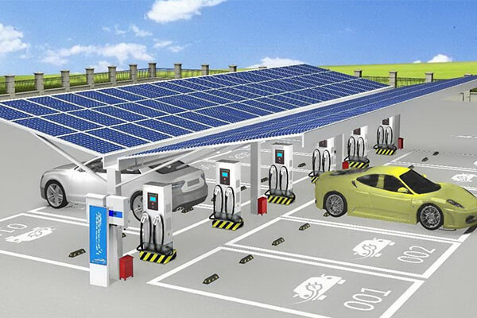

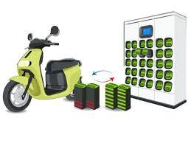
Project Title:
Design of IOT Architecture for Battery Charging Management System
Theme of the Project:
Battery Swapping station and EV Charging Infrastructure

Slide 2
Abstract
Features:
Real-time monitoring, predictive analytics, mobile charging units, centralized cloud platform, and user-friendly mobile app.
Problem:
Rapid EV adoption faces challenges like range anxiety, inconsistent charging, and limited infrastructure.
Solution:
IoT-based architecture for efficient battery charging.
Significance:
Addresses critical issues in EV charging, contributes to a cleaner future, and drives technological advancement.
Benefits:
Enhanced user experience, optimized energy management, improved accessibility, and promotion of EVs and sustainable energy.

Slide 3
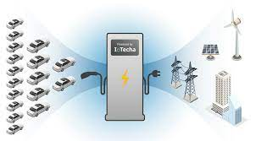
Introduction
Rapid growth of electric vehicles (EVs) increasing demand for efficient charging infrastructure.
Need for sustainable solutions integrating renewable energy sources like solar power and energy storage systems (ESS).
Objective:
Develop an IoT-based architecture to optimize battery charging management.
Utilize real-time data monitoring and predictive analytics to enhance efficiency.
Key Benefits:
Significant reduction in operational costs, achieving up to 88.5% cost efficiency.
Enhanced battery management through real-time monitoring of critical parameters (voltage, temperature, SOC).
Future Scope:
Optimize operations and automate maintenance.
Expand charging infrastructure to meet growing demand.
Market Demand:
Increasing EV sales necessitating more charging stations.
Consumer preference shifting towards renewable energy-powered solutions.

Slide 4
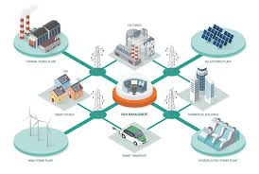
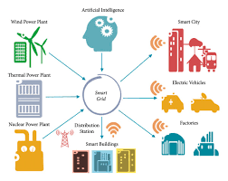


Motivation, Research Gap & Problem, Novelty
Motivation
The rapid growth of electric vehicles (EVs) necessitates a robust and efficient charging infrastructure.
Integrating renewable energy sources like solar power into charging systems aligns with environmental sustainability goals.
The need to reduce operational costs in charging management drives innovation with IOT in battery management technologies.
Research Gap & Problem
Absence of uniform standards for EV charging stations leads to compatibility issues across different systems.
More research is needed to understand consumer preferences and behaviors regarding EV charging solutions.
Limited Integration of Renewable Energy Sources
Absence of Comprehensive IoT-Based Charging Management
No Holistic Approach to Grid Stability
Minimal Real-Time Monitoring and Control Capabilities
Novelty
The proposed architecture uniquely combines IoT technology for real-time monitoring in battery charging management.
The five-layered architecture and PCC with source integration and automation provides a comprehensive approach to optimize charging processes.
Preliminary simulations indicate a potential reduction of up to 88% in operational costs through optimized resource utilization.
IOT
Connectivity
Real Time monitoring
Load management
Grid Stability
Algorithm

Slide 5
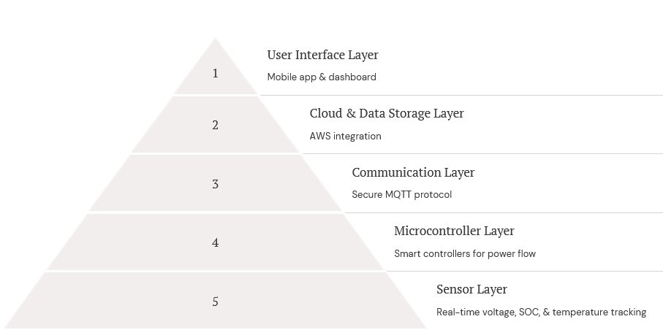
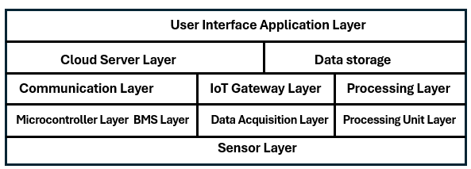
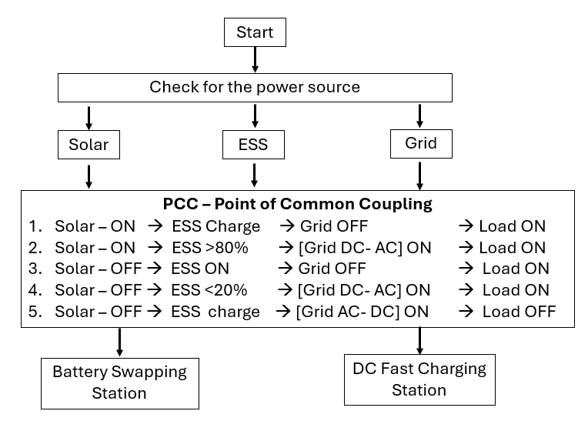
Methodology
This methodology aims to create a comprehensive IoT architecture that enhances battery charging management while promoting sustainability through the integration and Automation of renewable energy sources with Realtime monitoring
Point of Common Coupling - PCC
Point of Common Coupling for integration and Automation
  Combines solar power, Energy Storage Systems (ESS), and grid power at the Point of Common Coupling.

Slide 6
Methodology
Algorithms for Proposed Methodology
MPPT (Maximum Power Point Tracking) Algorithm:
  Optimizes solar panel output by continuously adjusting the operating point to maximize energy capture under varying conditions.
Battery Swapping Station Algorithm:
  Manages logistics and scheduling for battery swaps, optimizing inventory and availability of charged batteries to improve service efficiency.
Vehicle Charging Control Calculation:
  Calculates optimal charging rates based on battery state-of-charge (SOC) and user demand, ensuring safe and efficient charging.
Safety and Blast Condition Prediction using Machine Learning:
  Utilizes machine learning models to analyze historical data and predict potential safety hazards in battery charging environments, enabling proactive risk management.
AWS Cloud Integration Methodology
Secured MQTT Protocol:
  Utilizes MQTT for secure and efficient communication between IoT devices and the cloud.
S3 Bucket Data Storage:
  Stores collected data in Amazon S3 for scalable and durable storage solutions.
Email Alerts:
  Implements automated email notifications for critical events or alerts related to battery charging management.
Data Visualization:
  Provides real-time data visualization dashboards to monitor charging status and performance metrics.

Slide 7
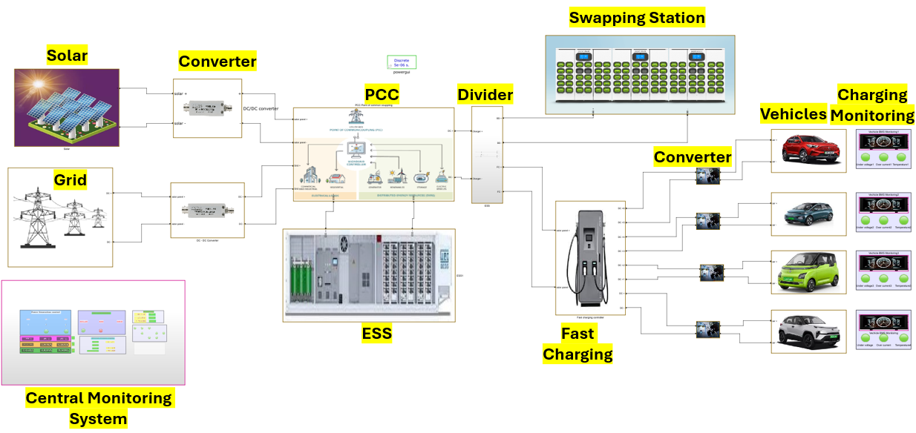
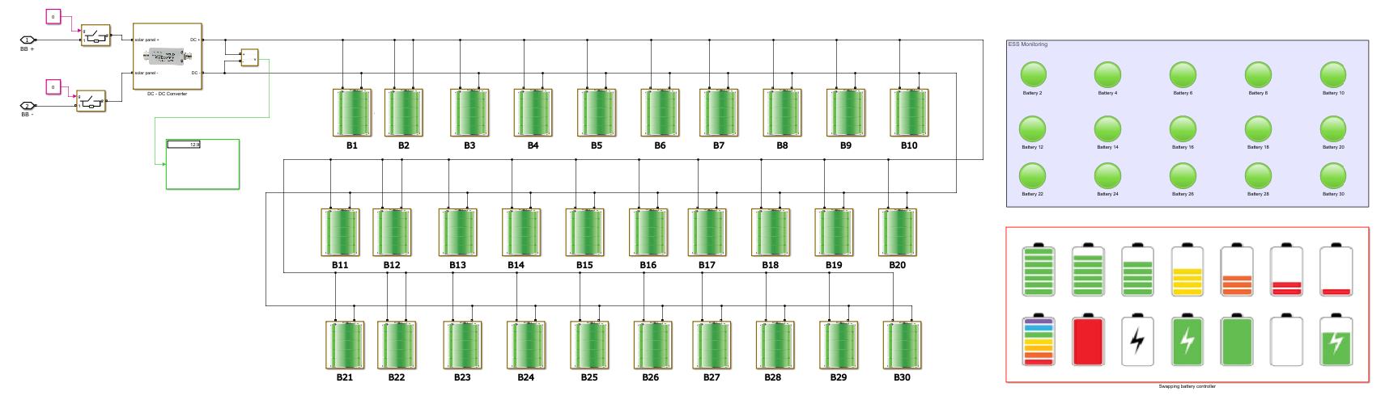
Results –Simulation models
Simulation Model
Battery Swapping station
EV Charging

Slide 8
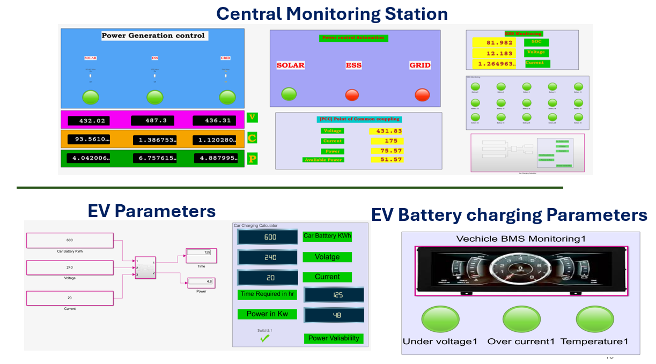
Results
AWS Cloud Connectivity
Visualization - Monitoring

Slide 9
Estimated Energy and Cost calculation
Power Generation |  |  |  |  |  |  | PCC - Point of common coupling |  |  |  |  | ESS - Charging
Power Source | Voltage [V] | Current [I] | % of Generation/day | Power [P]- KWh | Power/day |  | PCC will Logically be controlled on availability of source |  |  |  |  | No.of batteries | 40
Solar | 430 | 100 | 60 | 43 | 1032 |  | Voltage - [V] | 430 | Output Power/day in KW |  |  | Voltage | 12
ESS | 480 | 50 | 30 | 24 | 576 |  | Current - [I] | 80 |  |  |  | Amper hour - capacity | 100
Grid | 435 | 20 | 10 | 9 | 209 |  | Power - [W] - KW/h | 75 | 1800 | Gen /day |  | Power / charge - Watt / hr | 48000
Total Power Generation per day in KW/24 hr |  |  |  |  | 1817 |  | Power Avaliability | 1.17 | 1772 | use / day |  | Power / one cycle charge - KW | 48
Fast Charging Station Load
Cars | Voltage (V) | Power (kW) | Battery Capacity (kWh) | SOC Avaliable | Required Current |  | Charging Time in hr |  | Unit charge | Cost
1 - Tata Nexon - EV | 400 | 30.2 | 30.2 | 20 | 75.5 |  | 2.47 |  | 10 | 745.83
2- MG ZS EV | 400 | 50 | 44.5 | 30 | 125 |  | 1.49 |  | 10 | 743.75
3-Tata Trigo EV | 400 | 16.8 | 26 | 50 | 42 |  | 4.40 |  | 10 | 739.58
4- Mahindra eVerito | 400 | 70 | 60 | 10 | 175 |  | 1.07 |  | 10 | 747.92
Total Power |  | 167 |  |  | Total Time |  | 9 |  | Total Revenue | 2977
Total Power |  | 1670 | KW power can charge / day |  | Total Time |  | 94 | / 96 hr | Total Revenue | 26794
Battery Swapping Station
Total Batteries | 30
Under maintance | 0
Avaliable batteries | 30
Voltage | 12 |  | Total Batteries charging / day |  |  | 90
Current | 10 |  | Cost of charge per battery |  |  | 30
Time / Battery in hr | 5 |  | Total Amout Per day |  |  | 2700
No of Cycle per day | 3
Power/Battery - KW | 0.12
Total Station KW | 18
Total Energy Required for Full Swapping Station per Day - KW | 54

Slide 10
Total Energy calculation
Power sources | KW / day | KW / Month | KW / year | KW / 5 years
Required full Power From Grid | 1,817 | 54,504 | 663,132 | 3,315,660
Solar | 1,032 | 30,960 | 376,680 | 1,883,400
ESS | 576 | 17,280 | 210,240 | 1,051,200
Grid | 209 | 6,264 | 76,212 | 381,060
Total Power saving / Day | 1,608 | 48,240 | 586,920 | 2,934,600
Total Cost / Day 12rs / unit | 21,802 | 654,048 | 7,957,584 | 39,787,920
Total Cost Saving / Day 12rs / unit | 19,296 | 578,880 | 7,043,040 | 35,215,200
Spending Amount | 2,506 | 75,168 | 914,544 | 4,572,720
Revenue
Source | Per day | Per Month | Per Year | Per 5 Years
Fast charging | 26,794 | 803,813 | 9,779,719 | 48,898,594
Battery Swapping | 2,700 | 81,000 | 985,500 | 4,927,500
Total Revenue | 29,494 | 884,813 | 10,765,219 | 53,826,094
Spending Amount | 2,506 | 75,168 | 914,544 | 4,572,720
Total Profit | 26,988 | 809,645 | 9,850,675 | 49,253,374

Slide 11

Conclusion
Conclusion
The proposed IoT architecture effectively addresses the growing demand for efficient EV charging infrastructure.
It promotes sustainability by integrating renewable energy sources, enhancing operational efficiency, and reducing costs.
Real-time monitoring and predictive analytics contribute to improved battery management and a greener transportation ecosystem.
Patent

Slide 12
Thankyou

